Slide 1
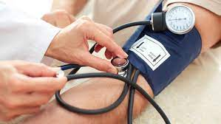
Blood Pressure Health Tracker
Students
Adham Abu Hantash
Batool Nawasra
Razan Harasha
Saeed Sabra
Doctor
Dr. Yousef Daraghmeh

Slide 2
Project idea – problem statements
The problem that the project aims to solve is the lack of systems that allow the patient to monitor his health without going to the doctor, and if it exists, its accuracy is low, as this lies in the difficulty of accurately assessing the health status of an individual using traditional methods, which can be time-consuming, subjective, and prone to errors, in addition to the fact that medical examinations and procedures may be expensive, which makes them unavailable to some individuals.

Slide 3
Similar projects
Advantages and disadvantages of them
In our project support both English and Arabic

Slide 4
Data sets
Multiple and way we use this data set and do some operation on it

Slide 5
Algorithms used and its accuracies
The algorithms we used and which algorithm we use in the a\last and way with screen shots

Slide 6
ML model
Deep learning with keras

Slide 7


Backend and data base used and why to use it (store data)

Slide 8



Front end and frame work used (bootstrap , MUI)

Slide 9
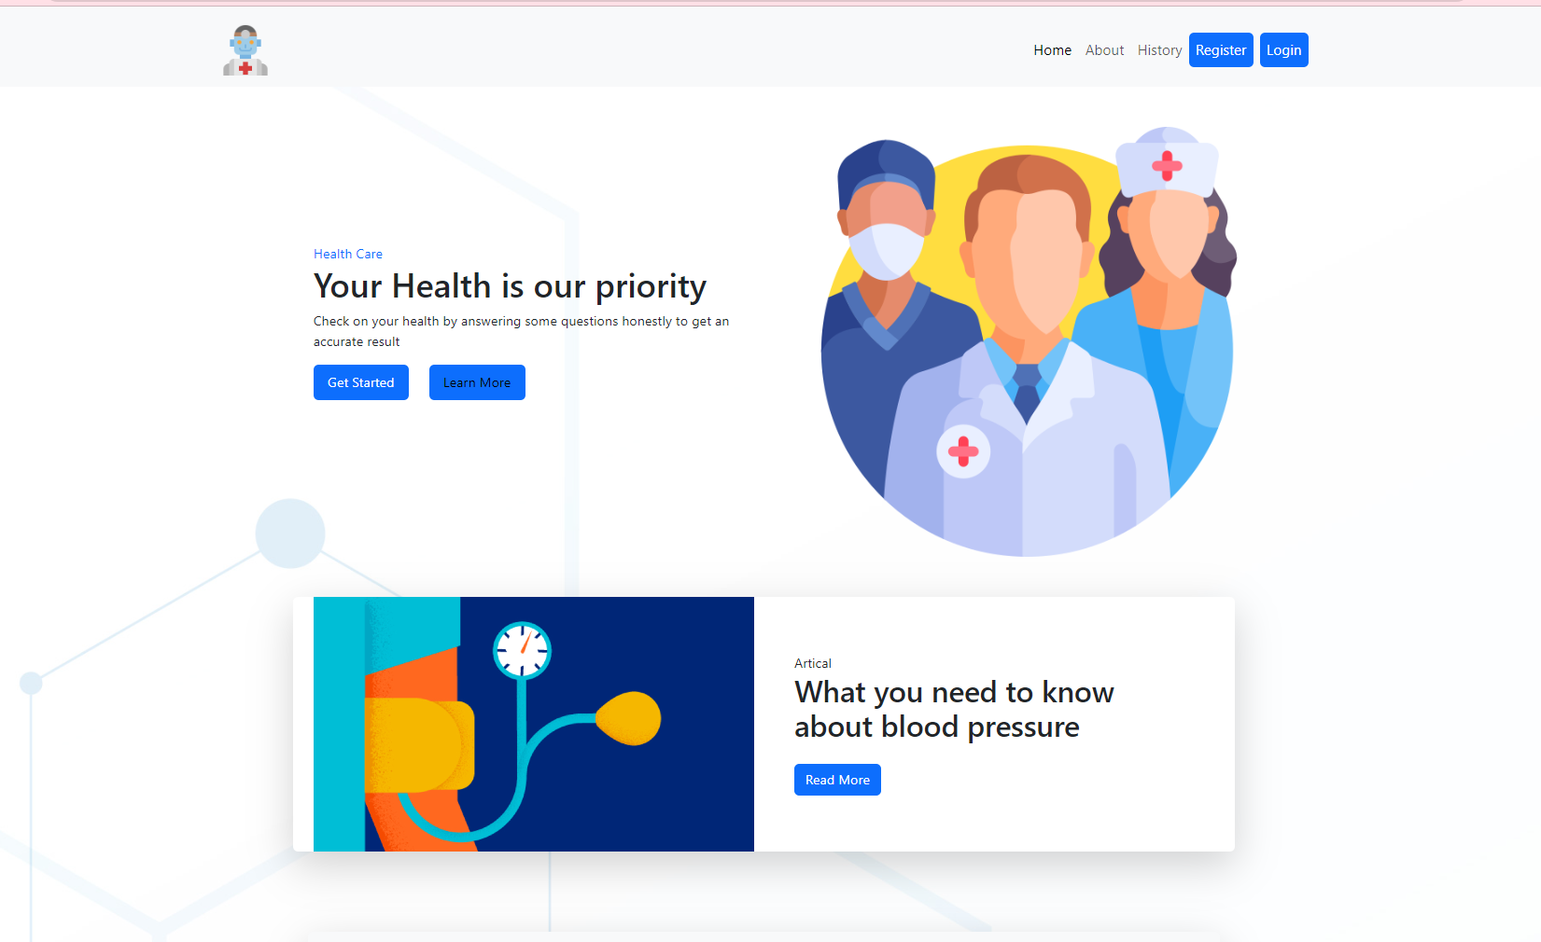
Picture to the project

Slide 10
Usage
Register: Sign up with a valid email. A verification email will be sent to your registered email address.
Verify Email: Visit your email inbox, click the verification link, and return to the app.
Login: Log in to the system with your registered credentials.
Make a Test: Complete the test to receive your blood pressure stage prediction.
View History: Review your previous test details and results in the history section.
Explore Articles: Utilize the integrated articles to enhance your knowledge about blood pressure.

Slide 11
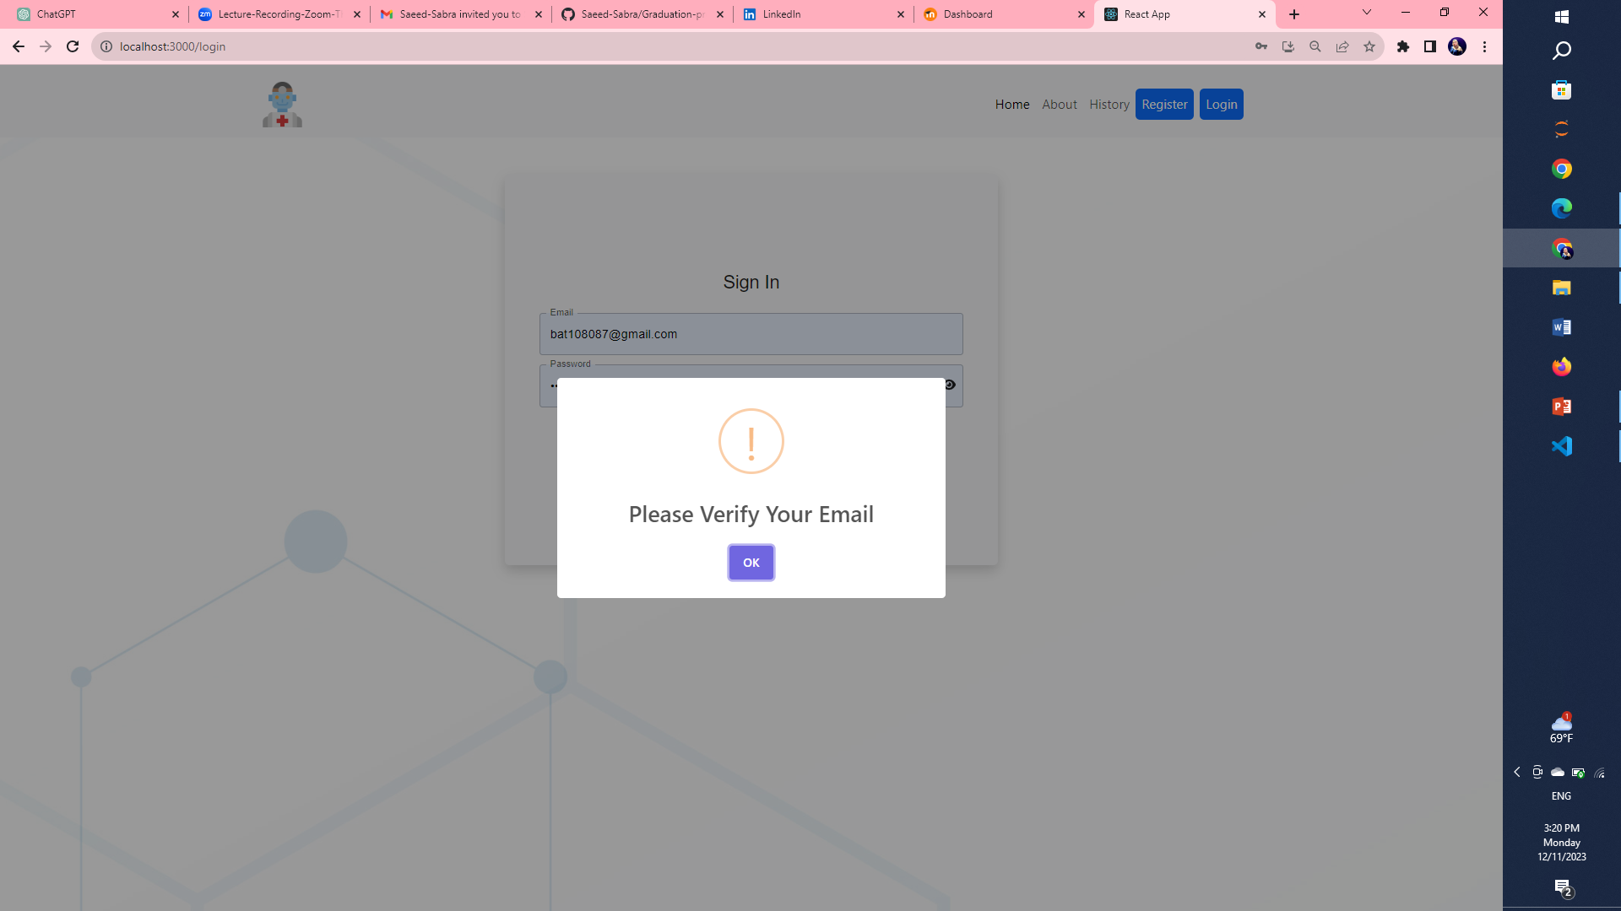
Registor and log in

Slide 12
Do a test

Slide 13
View history of user

Slide 14
Thanks for your

